Slide 1


Social Buzz
Insights

Slide 2


Today's agenda
Project recap
Problem
The Analytics team
Process
Insights
Summary

Slide 3


t
Social Buzz is a fast growing technology unicorn that need to adapt quickly to it’s global scale.
Accenture has begun a 3 month POC focusing on these tasks:
An audit of Social Buzz’s big data practice
Recommendations for a successful IPO
Analysis to find Social Buzz’s top 5 most popular categories of content
Project Recap

Slide 4


Problem
Over 100.000 posts per day
36.500.000 pieces of content per year!
But how to capitalize on it when there is so much?
Analysis to find Social Buzz’s top 5 most popular categories of content

Slide 5



Andrew Fleming
Chief Technical Architect
The Analytics team
Marcus Rompton
Senior Principle
Ariel Winter
Data Analyst

Slide 6

Process
1
Data Understanding
2
Data Cleaning
3
Data Modeling
4
Data Analysis
5
Uncover Insights

Slide 7


Insights
There are also some other interesting insights that we might want to share with you:
How many unique categories are there?
How many reactions are there to the most popular category?
How many sentiments to each content type?

Slide 8
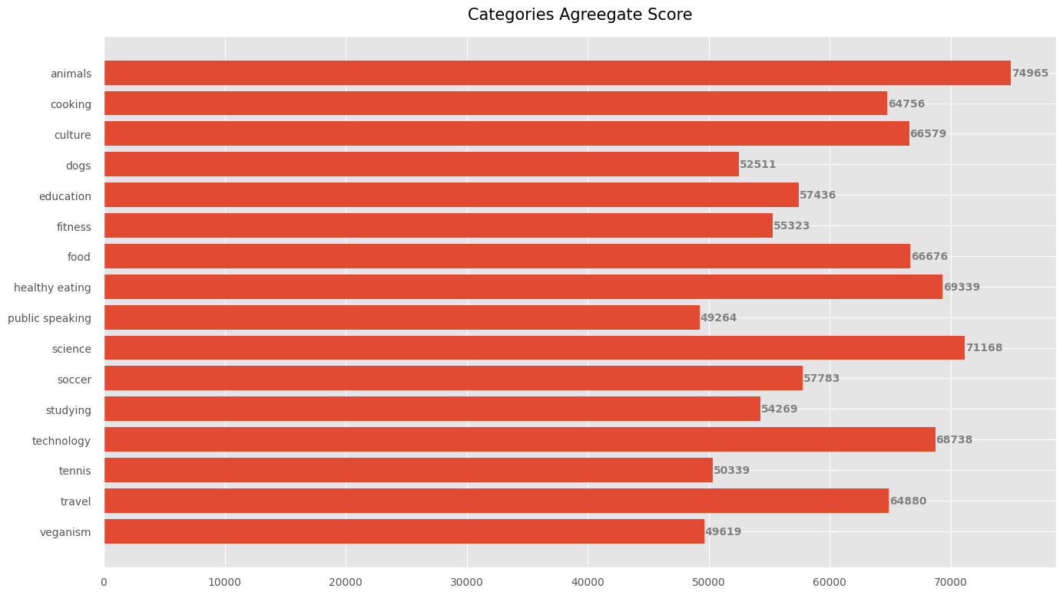
There are 16 unique categories. In which, animal category is the most popular with highest score.

Slide 9
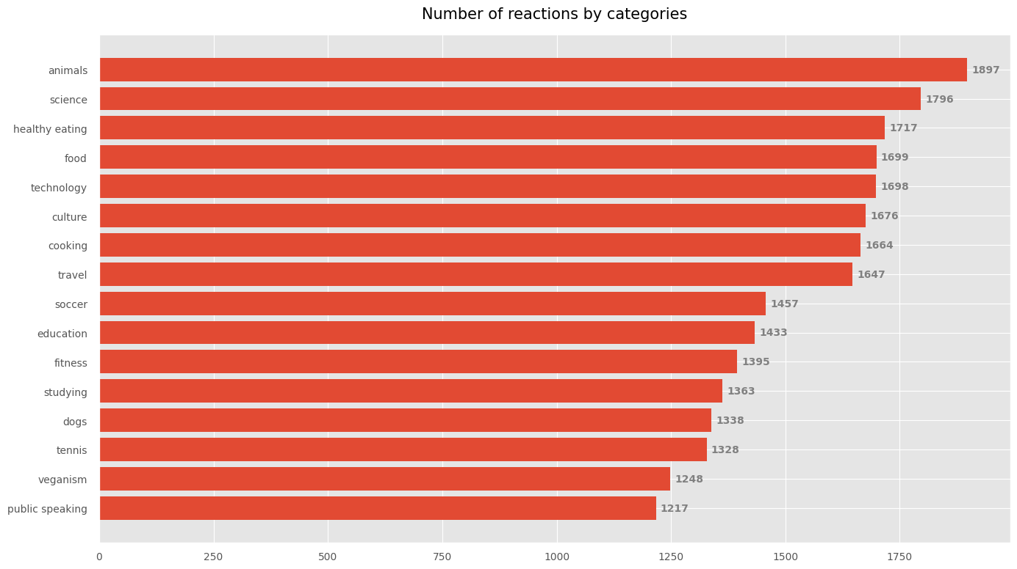
Animal category also have the highest number of reaction.

Slide 10
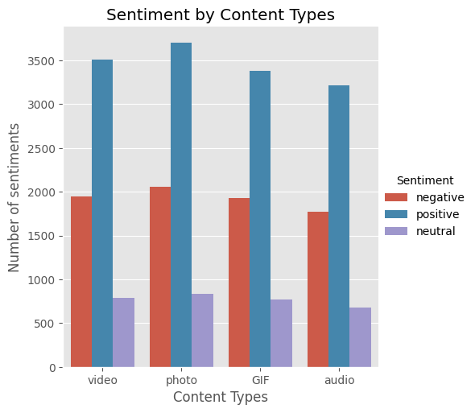
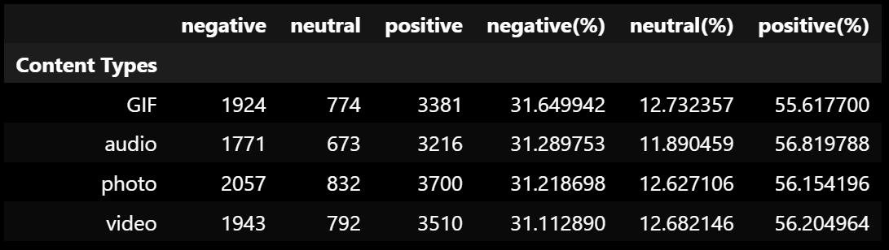
The proportion of each sentiment in each type of content is approximately the same.

Slide 11


ANALYSIS
Animal and science are the two most popular categories of content, showing that people enjoy “real-life” and “factual” content the most.
Summary
INSIGHT
Food is a common theme with the top 5 categories with “Healthy Eating” ranking the highest. This may give an indication to the audience within your user base. You could use this insight to create a campaign and work with healthy eating brands to boost user engagement.
NEXT STEP
This ad-hoc analysis is insightful, but it’s time to take this analysis into large scale production for real-time understanding of your business. We can show you how to do this.

Slide 12

Thank you!
ANY QUESTIONS?

